Slide 1
Real time face mask detection from CCTV and Images
TEAM: MACHINE MASTERS
1.PURANI GANTLA
2.JAIRAM PEETHALA
3.SAI CHARAN BORA
4.SAI AKASH VARMA SIVANGAM

Slide 2
PROBLEM STATEMENT
Wearing a mask in public settings is an effective way to keep the communities safe. As a response to the COVID-19 pandemic, we open-sourced a face mask detection application that uses ML to detect if people are wearing masks or not. We focused on making our face mask detector ready for real-world applications , such as CCTV cameras.

Slide 3
ABSTRACT
We aim to design a binary face classifier which can detect any face present in the frame irrespective of its alignment. We present a method to generate accurate face segmentation masks from any arbitrary size input image. Beginning from the RGB image of any size, the method uses Predefined Training Weights of VGG - 16 Architecture for feature extraction.
Training is performed through Fully Convolutional Networks to semantically segment out the faces present in that image. Gradient Descent is used for training while Binomial Cross Entropy is used as a loss function. Further the output image from the FCN is processed to remove the unwanted noise and avoid the false predictions if any and make bounding box around the faces.
Face Mask Detection system built with OpenCV, Keras/TensorFlow using Deep Learning and Computer Vision concepts in order to detect face masks in static images as well as in real-time video streams.

Slide 4
EXISTING SYSTEM
Initially researchers focused on edge and gray value of face image. was based on pattern recognition model, having a prior information of the face model. Ad boost was a good training classifier. The face detection technology got a breakthrough with the famous Viola Jones Detector which greatly improved real time face detection.

Slide 5
DISADVANTAGES
Existing systems was mainly developed for detecting facial features but not for facial mask detection.
Existing methods are based on image processing and time taken for processing is high compare to machine learning.

Slide 6
PROPOSED SYSTEM
We propose a method of obtaining segmentation masks directly from the images containing one or more faces in different orientation. The input image of any arbitrary size is resized to 224 × 224 × 3 and fed to the FCN network for feature extraction and prediction. The output of the network is then subjected to post processing.
Initially the pixel values of the face and background are subjected to global thresholding. After that its passed through median filter to remove the high frequency noise and then subjected to Closing operation to fill the gaps in the segmented area. After this bounding box is drawn around the segmented area.

Slide 7
ADVANTAGES
In this project new model is trained using LabelBinarizer and mask model is created.
Application can be used in live camera and images.

Slide 8
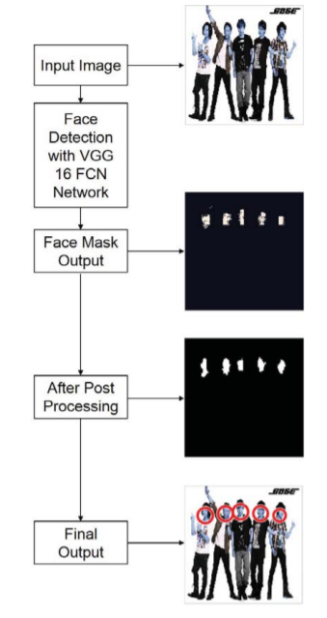
ARCHITECTURE

Slide 9
Image Preprocessing :
The images captured by the CCTV cameras required preprocessing before going to the next step. In the preprocessing step, the image is transformed into a grayscale image because the RGB color image contains so much redundant information that is not necessary for face mask detection. RGB color image stored 24 bit for each pixel of the image. On the other hand, the grayscale image stored 8 bit for each pixel and it contained sufficient information for classification. Then, we reshaped the images into (64×64) shape to maintain uniformity of the input images to the architecture. Then, the images are normalized and after normalization, the value of a pixel resides in the range from 0 to 1. Normalization helped the learning algorithm to learn faster and captured necessary features from the images.
Deep Learning Architecture
The deep learning architecture learns various important nonlinear features from the given samples. Then, this learned architecture is used to predict previously unseen samples. To train our deep learning architecture, we collected images from different sources. The architecture of the learning technique highly depends on CNN. All the aspects of deep learning architecture are described below
Dataset Collection:
Data from two different sources [19], [20] are collected for training and testing the model. We collected a total of 858 images of people with masks and 681 images of people without a mask. For training purposes, 80% images of each class are used and the rest of the images are utilized for testing purposes.
Architecture Development:
The learning model is based on CNN which is very useful for pattern recognition from images [21]. The network comprises an input layer, several hidden layers and an output layer. The hidden layers consist of multiple convolution layers that learn suitable filters for important feature extraction from the given samples. The features extracted by CNN are used by multiple dense neural networks for classification purposes. The architecture of the developed network is illustrated in Table I. The architecture contains three pairs of convolution layers each followed byone max pooling layer. This layer decreases the spatial size of the representation and thereby reduces the number of parameters. As a result, the computation is simplified for the network. Then, a flatten layer reshapes the information into a vector to feed into the dense network. Three pairs of dense and dropout layers learn parameters for classification. The dense layer comprises a series of neurons each of them learn nonlinear features. The dropout layer prevents the network from overfitting by dropping out units. Finally, a dense layer containing two neurons distinguishes the classes.

Slide 10
SOFTWARE HARDWARE REQUIREMENT
HARDWARE REQUIREMENTS:
System : Pentium IV 2.4 GHz.
Hard Disk : 100 GB.
Monitor : 15 VGA Color.
Mouse : Logitech.
RAM : 1 GB.

Slide 11
SOFTWARE REQUIREMENTS:
Operating system : Windows XP/7/10
Coding Language : python
Development Kit anaconda
Library : TensorFlow, keras, OpenCV
Dataset : with and without mask dataset

Slide 12
REFERENCES
T.-H. Kim, D.-C. Park, D.-M. Woo, T. Jeong, and S.-Y. Min, “Multi-class classifier-based adaboost algorithm,” in Proceedings of the Second Sinoforeign-interchange Conference on Intelligent Science and Intelligent Data Engineering, ser. IScIDE’11. Berlin, Heidelberg: Springer-Verlag, 2012, pp. 122–127.
[3] P. Viola and M. J. Jones, “Robust real-time face detection,” Int. J. Comput. Vision, vol. 57, no. 2, pp. 137–154, May 2004.
[4] P. Viola and M. Jones, “Rapid object detection using a boosted cascade of simple features,” in Proceedings of the 2001 IEEE Computer Society Conference on Computer Vision and Pattern Recognition. CVPR 2001, vol. 1, Dec 2001, pp. I–I.
[5] J. Li, J. Zhao, Y. Wei, C. Lang, Y. Li, and J. Feng, “Towards real world human parsing: Multiple-human parsing in the wild,” CoRR, vol. abs/1705.07206.

Slide 13
THANK YOU

